Slide 1

Design And Development Of Corporate Website
Review 1
Work done by
Under The Guidance of
ROHITH S
DR. N.MAHENDIRAN Msc.,Mphil.,ph.D
Sri Ramakrishna college of arts & science
23106108
III BSC CS

Slide 2
Abstract
This project presents the design and development of a dynamic web platform for Vijay Industries, a company specializing in the reselling of electrical transformers. The website aims to streamline product visibility, customer engagement, and sales operations by providing an intuitive and user-friendly interface. Key features include a comprehensive product catalog, detailed transformer specifications, inquiry and quotation modules, and an efficient content management system for easy updates. The platform enhances the company’s digital presence, allowing customers to conveniently browse available transformer models, compare specifications, and request quotations online. By integrating modern web technologies and responsive design principles, the website ensures accessibility across devices and improves overall customer experience. This project ultimately supports Vijay Industries in expanding its market reach, optimizing communication, and strengthening its position within the transformer reselling sector..
2

Slide 3
Existing system
The new clients can’t reach easily and the response time is delaying
The company has to show the catalogue to everyone personally it’s a time delaying process
The quotation models are not efficient to send.

Slide 4
Proposed solution
The website aims to streamline product visibility, customer engagement, and sales operations by providing an intuitive and user-friendly interface.
Key features include a comprehensive product catalog, detailed transformer specifications, inquiry and quotation modules, and an efficient content management system for easy updates.
And conveniently browse available transformer models, compare specifications, and request quotations online.

Slide 5
Software Requirements
Platform used : Visual studio code,Cursor
Languages used : Html,CSS,Java script
Database : Firebase

Slide 6
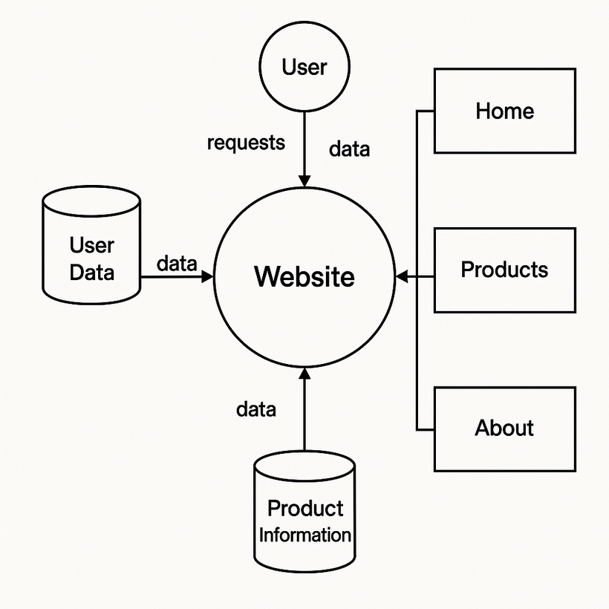
Data Flow Diagram

Slide 7
THANK YOU !

